Slide 1
Artificial Intelligence

Slide 2
Outline
Last Class
Problem Solving
Classical Approach
Problem Representation
Searching and Categories of the search algorithm
Today
Properties of Search Algorithms
Uninformed Search Algorithms
Breadth-first search
Depth-first search
Depth-limited search
Uniform-cost search
Iterative deepening search

Slide 3
Properties of Search Algorithms
Following are the four essential properties of search algorithms to compare the efficiency of these algorithms:
Completeness: Does it always find a solution if one exists?
Optimality: whether the algorithm found a best solution (lowest path cost) ?
Time complexity: A measure of time for an algorithm to complete its task. i.e. number of nodes generated/expanded
Space complexity: The maximum storage space required at any point during the search (Maximum nodes in memory)
Notes:
The parameters used to evaluate the performance of algorithms.

Slide 4
Uninformed Search Algorithms
Use only the information available in the problem definition
Carried out without any additional information that is already provided in the problem statement
How to traverse the tree, how to identify leaf and goal nodes
Solution cost is not taken into account
Breadth-first search
Depth-first search
Depth-limited search
Uniform-cost search
Iterative deepening search

Slide 5
Breadth-first search (BFS)
The most common search strategy for traversing a tree or graph
This algorithm searches breadthwise in a tree or graph and progresses downward level by level
The breadth-first search algorithm is an example of a general-graph search algorithm.
Breadth-first search implemented using FIFO queue data structure.

Slide 6
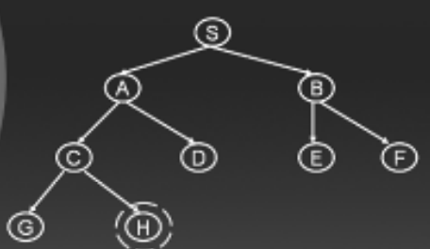
Contd..

Slide 7
Simple search algorithm
Let S be the start state
Initialize Q with the start node Q=(S) as the only entry; set Visited = (S)
If Q is empty, fail. Else pick node X from Q
If X is a goal, return X, we’ve reached the goal
(Otherwise) Remove X from Q
Find all the children of state X not in Visited
Add these to Q; Add Children of X to Visited
Go to Step 2

Slide 8
Contd..
S
Add S in output, mark as visited, and make first currently working node (CWN), check for goal
Output: S
A
B
C
D
E
F
G
H

Slide 9
Contd..
S
If S is not goal, Check all unvisited adjacent nodes of S, enqueue them and also mark as visited
Output: S A B
A
B
C
D
E
F
G
H
A | B

Slide 10
Contd..
S
Update CWN. Check first element in Q i.e. A. make it CWN and dequeue it. Check for goal
Output: S A B
A
B
C
D
E
F
G
H
A | B

Slide 11
Contd..
S
If A is not goal, Check all unvisited adjacent nodes of A, enqueue them and also mark as visited
Output: S A B C D
A
B
C
D
E
F
G
H
A | B | C | D

Slide 12
Contd..
S
Update CWN. Check first element in Q i.e. B. make it CWN and dequeue it. Check for goal.
Output: S A B C D
A
B
C
D
E
F
G
H
A | B | C | D

Slide 13
Contd..
S
If B is not goal, Check all unvisited adjacent nodes of B, enqueue them and also mark as visited
Output: S A B C D E F
A
B
C
D
E
F
G
H
A | B | C | D | E | F

Slide 14
Contd..
S
Update CWN. Check first element in Q i.e. C. make it CWN and dequeue it. Check for goal.
Output: S A B C D E F
A
B
C
D
E
F
G
H
A | B | C | D | E | F | G | H

Slide 15
Contd..
S
If C is not goal, Check all unvisited adjacent nodes of C, enqueue them and also mark as visited
Output: S A B C D E F G H
A
B
C
D
E
F
G
H
A | B | C | D | E | F | G | H

Slide 16
Contd..
S
Update CWN. Check first element in Q i.e. D. make it CWN and dequeue it. Check for goal.
Output: S A B C D E F G H
A
B
C
D
E
F
G
H
A | B | C | D | E | F | G | H

Slide 17
Contd..
S
Check all unvisited adjacent nodes of D, No unvisited node, no enqueue, Update CWD and check for goal
Output: S A B C D E F G H
A
B
C
D
E
F
G
H
A | B | C | D | E | F | G | H

Slide 18
Contd..
Now, as there is no unvisited node left, every node left in Q will be made CWD and checked for goal, sequentially, and gets removed from the Q.
When the last node H is removed from Q and checked for goal, the algorithm says YES.
The path to achieve goal will be:
S A B C D E F G H
BFS travels a significant area of the search space if the solution is located somewhere deep inside the tree

Slide 19
Pros and Cons
Advantages
Provides a solution if any solution exists.
If there are more than one solutions for a given problem, then BFS will provide the minimal solution which requires the least number of steps.
Disadvantages
It requires lots of memory since each level of the tree must be saved into memory to expand the next level.
BFS needs lots of time if the solution is far away from the root node.

Slide 20
Performance Measurement
Complete ?
Yes (if b (max branch factor) is finite)
Optimal ?
Only if cost = 1 per step, otherwise not optimal in general
Time ?
O(n), where n is the number of nodes. Every node is traversed
Space ?
O(n), as in worst case you need to hold all vertices in the queue.

Slide 21
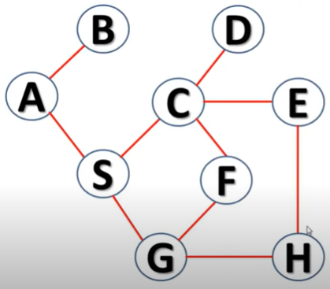
Task
Use BFS to traverse the graph starting from node A.

Slide 22
Depth-first search (BFS)
A recursive algorithm for traversing a tree or graph data structure.
It starts from the root node and follows each path to its greatest depth node before moving to the next path. That’s why called the depth-first search
The searching process is similar to the BFS algorithm.
DFS is implemented using LIFO i.e. stack data structure.
Flow: Root node--->Left node ----> right node.

Slide 23
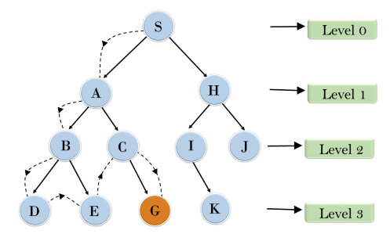
Contd..
Search from root node S->A->B->D->E,
After traversing E, it will backtrack the tree as E has no other successor and still goal node is not found. After backtracking it will traverse node C and then G, and here it will terminate as it found goal node.

Slide 24
Example
S
S
Add S in output and Stack, mark as visited, and make first currently working node (CWN), check for goal
Output: S
A
B
C
D
E
F
G
H

Slide 25
Example
S
A
S
If S is not goal, check next unvisited deepest adjacent node i.e. A. push A and also mark as visited
Output: S A
A
B
C
D
E
F
G
H

Slide 26
Example
S
C
A
S
If A is not goal, check next unvisited deepest adjacent node i.e. C. push C and also mark as visited
Output: S A C
A
B
C
D
E
F
G
H

Slide 27
Example
S
G
C
A
S
If C is not goal, check next unvisited deepest adjacent node i.e. G. push G and also mark as visited
Output: S A C G
A
B
C
D
E
F
G
H

Slide 28
Example
S
G
C
A
S
If G is not goal, check next unvisited deepest adjacent node. No node. pop G.
Output: S A C G
A
B
C
D
E
F
G
H

Slide 29
Example
S
H
C
A
S
The next node in stack is C. backtrack, check next unvisited deepest adjacent node of C i.e. H. push H and mark visited Output: S A C G H
A
B
C
D
E
F
G
H

Slide 30
Contd..
As H is the goal, so, it will stop and pop the nodes from stack.
The path to achieve the goal is :
S A C G H
To traverse all the nodes:

Slide 31
Example
The next node in stack is now, H. check next unvisited deepest adjacent node. No node. Pop H, C. Now A has one unvisited node D, push D and mark visited Output: S A C G H D
S
D
H
C
A
S
A
B
C
D
E
F
G
H

Slide 32
Example
The next node in stack is now, D. No unvisited deepest adjacent node. Pop D, A. Now S has one unvisited node B, push B and mark visited
Output: S A C G H D B
S
B
D
A
S
A
B
C
D
E
F
G
H

Slide 33
Example
The next node in stack is now, B. Two unvisited deepest adjacent node. Push E and mark visited
Output: S A C G H D B E
S
E
B
S
A
B
C
D
E
F
G
H

Slide 34
Example
The next node in stack is now, E. No unvisited deepest adjacent node. Pop E. Now B has one unvisited node F. push F and mark visited
Output: S A C G H D B E F
S
F
E
B
S
A
B
C
D
E
F
G
H

Slide 35
Example
The next node in stack is now, F. No unvisited deepest adjacent node. Pop F. Similarly pop B and finally S.
Output: S A C G H D B E F
S
F
B
S
A
B
C
D
E
F
G
H

Slide 36
Contd..
So, the whole tree is traversed using DFS and the path is:
S A C G H D B E F

Slide 37
Pros and Cons
Advantages
DFS requires very less memory as it only needs to store a stack of the nodes on the path from root node to the current node.
It takes less time to reach to the goal node than BFS algorithm (if it traverses in the right path).
Disadvantages
There is the possibility that many states keep re-occurring, and there is no guarantee of finding the solution.
DFS algorithm goes for deep down searching and sometime it may go to the infinite loop.

Slide 38
Performance Measurement
Complete ?
Complete within finite space but fails in infinite-depth spaces, spaces with loops. NO
Optimal ?
NO, as it may generate a large number of steps or high cost to reach to the goal node.
Time ?
O(n), where n is the number of nodes traversed.
Space ?
O(d), where d is the maximum depth of the tree.

Slide 39
Depth-Limited Search Algorithm
Similar to depth-first search with a predetermined limit, to guarantee that the algorithm ends.
The node at the depth limit will be treated as it has no successor nodes further.
Can solve the drawback of the infinite path in the DFS
Can be terminated with two Conditions of failure:
Standard failure value: It indicates that problem does not have any solution.
Cutoff failure value: It defines no solution for the problem within a given depth limit.

Slide 40
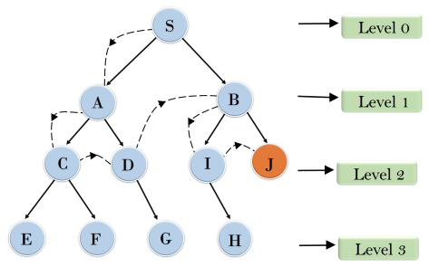
Contd..
An example with depth limit of 2.
Will traverse downward until level 2. if finds goal, terminates otherwise expand downwards by increasing depth limit (Level number)

Slide 41
Pros and Cons
Advantages
Depth-limited search is Memory efficient.
Disadvantages
Depth-limited search also has a disadvantage of incompleteness.
It may not be optimal if the problem has more than one solution.

Slide 42
Performance Measurement
Complete ?
complete if the solution is above the depth-limit.
Optimal ?
Yes (only if l > d) i.e. depth limit is above the maximum depth of the tree
Time ?
O(b^{l}) where, l -> depth-limit, b-> node at every state
Space ?
O(bl).

Slide 43
Uniform-cost Search
A searching algorithm to traverse a weighted tree or graph
A different cost is available for each edge
The primary goal is to find a path to the goal node, having the lowest cumulative cost
It searches next nodes according to their path costs
Implemented by the priority queue.
i.e. It gives maximum priority to the lowest cumulative cost
If the path cost of all edges is the same, its simply BFS

Slide 44
Pros and Cons
Advantages
optimal because at every state the path with the least cost is chosen.
Disadvantages
It does not care about the number of steps involved in searching and only concerned about path cost.

Slide 45
Performance Measurement
Complete ?
Yes, finds a solution if there is a solution.
Optimal ?
Optimal as it only selects a path with the lowest path cost.
Time ?
O(b^{(c/ϵ)}) where, ϵ -> is the lowest cost, c -> optimal cost
Space ?
O(b^{(c/ϵ)})

Slide 46
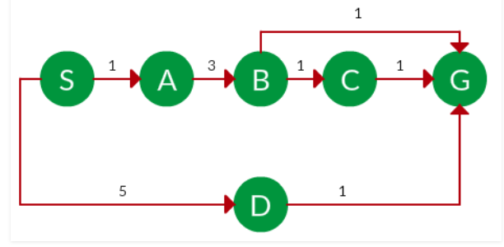
Task
Find the best path and also calculate the cost.

Slide 47
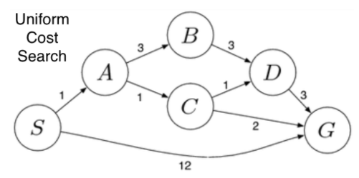
Optimal Solution??

Slide 48
Iterative deepening Depth First Search(IDDFS)
A combination of DFS and BFS algorithms
It searches for the best depth in each iteration
Searches until a certain depth and the depth keeps increasing at every iteration until it reaches the goal state.
Advantages:
It combines the benefits of BFS and DFS search algorithm in terms of fast search and memory efficiency.
Disadvantages:
Main drawback is that it repeats all the work of the previous phase.

Slide 49
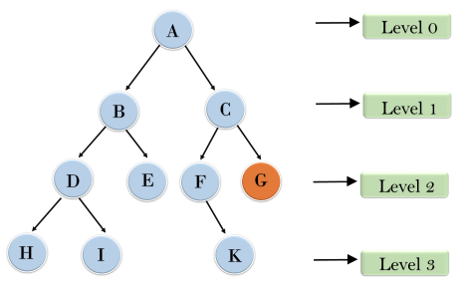
Contd..
1'st Iteration-----> A 2'nd Iteration----> A, B, C 3'rd Iteration------>A, B, D, E, C, F, G 4'th Iteration------>A, B, D, H, I, E, C, F, K, G In the fourth iteration, the algorithm will find the goal node.

Slide 50
Performance Measurement
Complete ?
Yes, (by limiting the depth).
Optimal ?
Yes (if step cost is uniform)
Time ?
O(b^{d}), where ‘b‘ – maximum branching factor in a tree and ‘d‘ – the depth of the least-cost solution.
Space ?
O(bd)

Slide 51
END

